Slide 1
Compliant Management System
The system which is developed caters the following:
It measures/monitors the end to end task assignment and gives a consolidated and up to date status of an issue/query/complaint.
It has multiple roles defined in it which ensures that every user has his/her set of privileges assigned to them to perform their respective tasks.

Slide 2
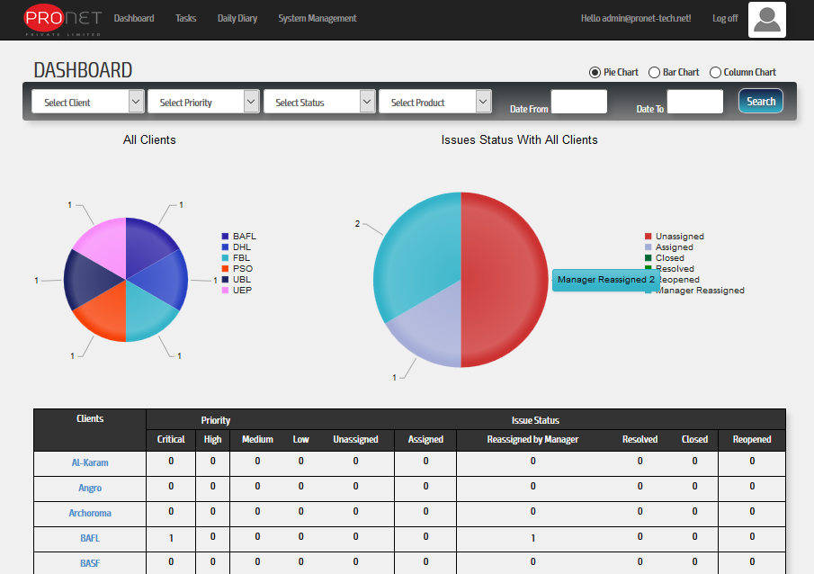
System Roles
Namely, following roles are available in the system
Administrator: The user with role ‘Admin’ in the software is capable to perform specific task as assigned by role.
Dashboard user with ‘Admin’ role can view his
dashboard for all tasks/issues statistics.

Slide 3
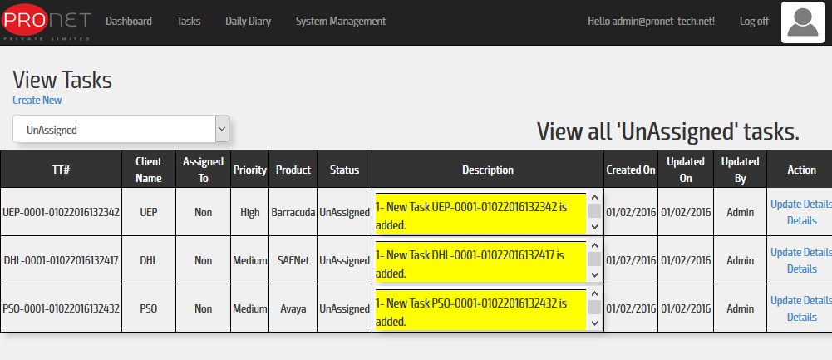
Task Management
Task Creation: When a task is created, email is send to mangers and supervisor.
View Task Detail: Administrator can view all tasks and their details.

Slide 4
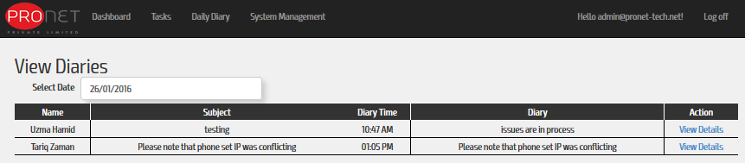
Daily Diary: User with ‘Admin’ role can view all other users filled diaries

Slide 5
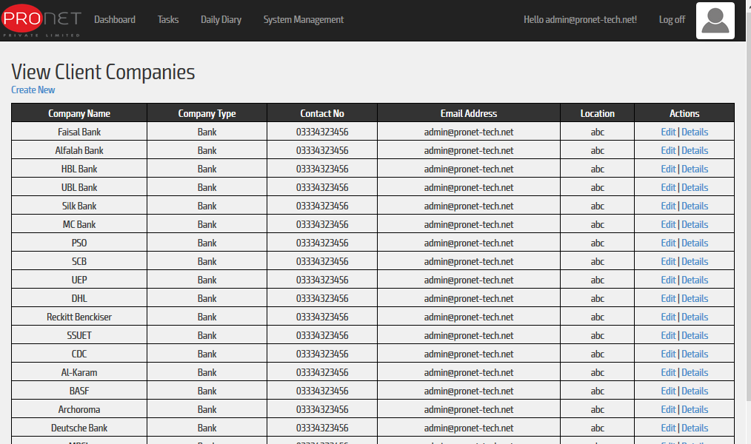
System Management
Client Company: Any task is always created against a client, user with ‘Admin’ role needs to initialize a client company data/information in the system.

Slide 6
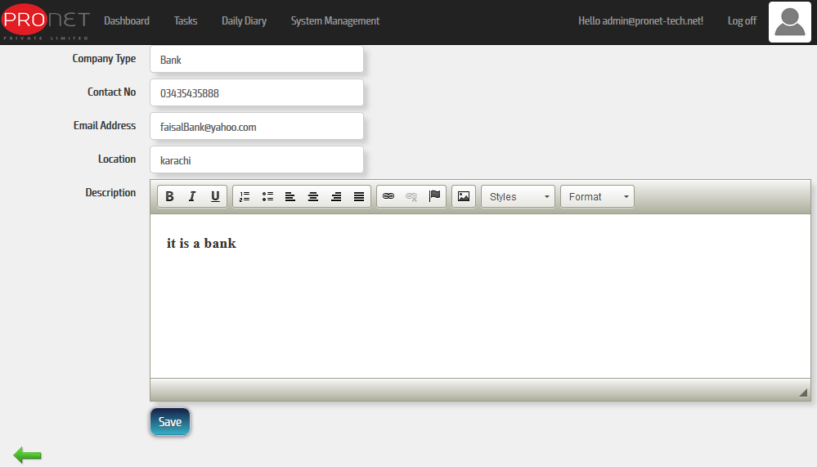
Can create new client company

Slide 7
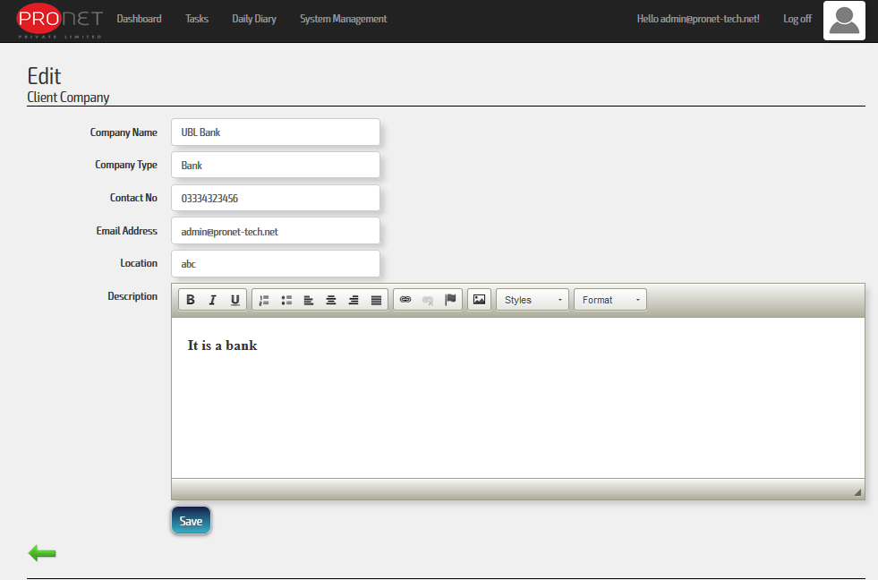
Can edit the existing one.

Slide 8
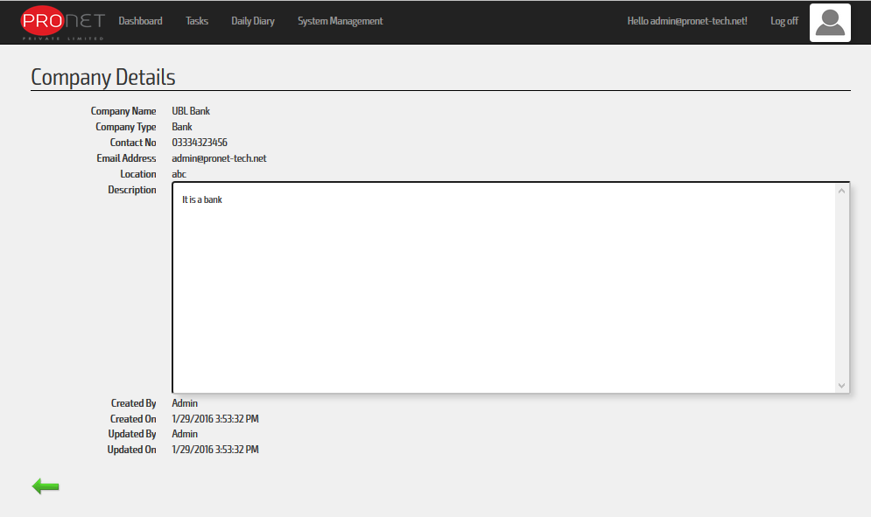
Can view any company detail.

Slide 9
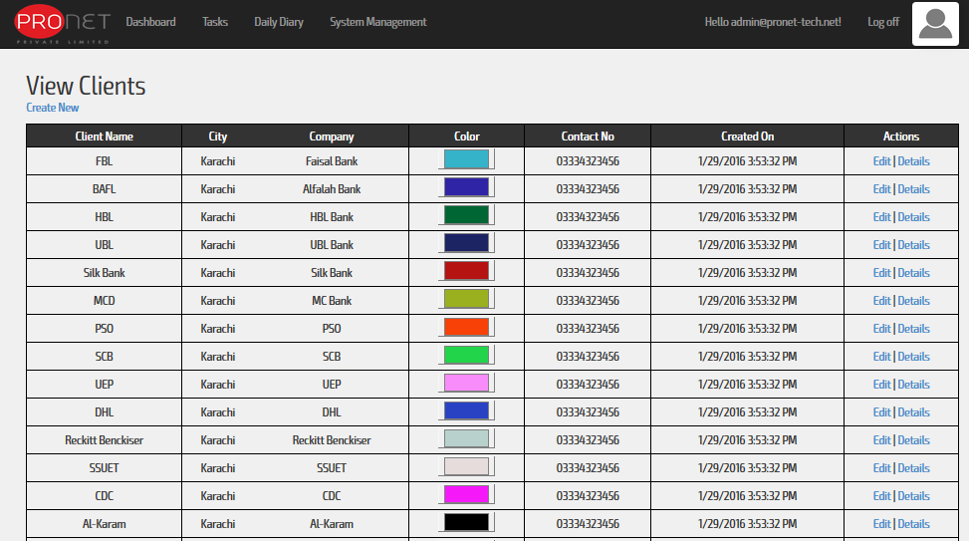
Company Client: Like client company, client initialization can be performed by user with ‘Admin’ role.

Slide 10
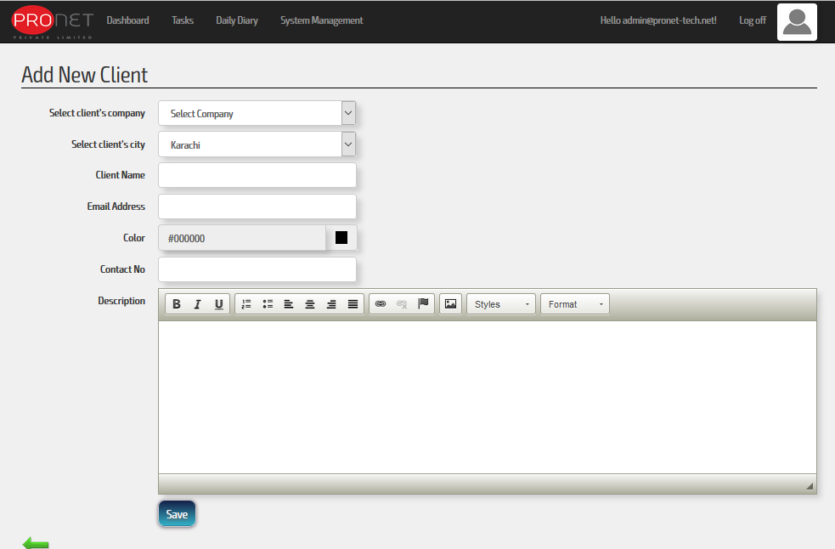
Can create new Client

Slide 11
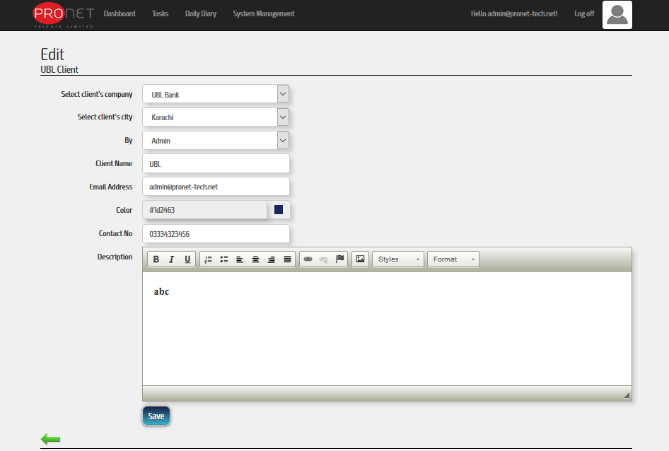
Can edit the existing one.

Slide 12
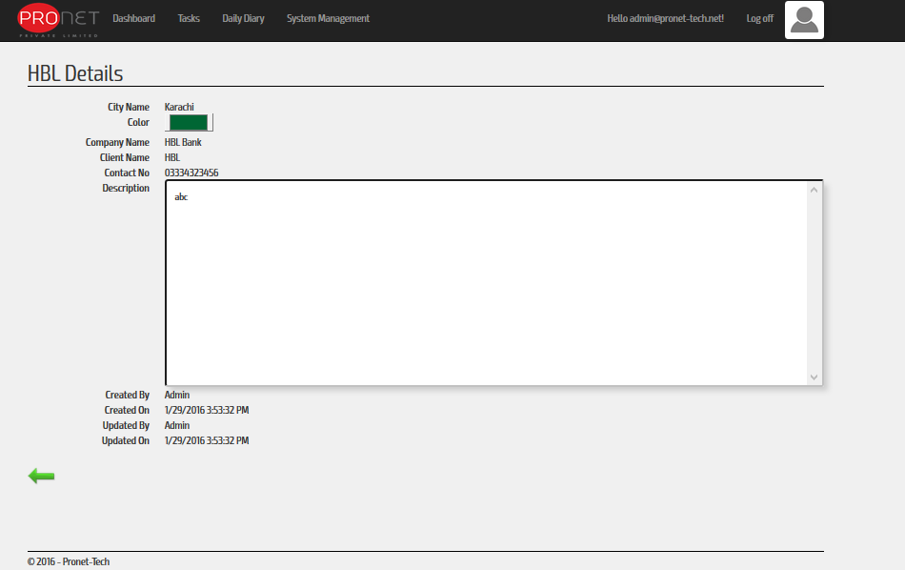
Can view details.

Slide 13
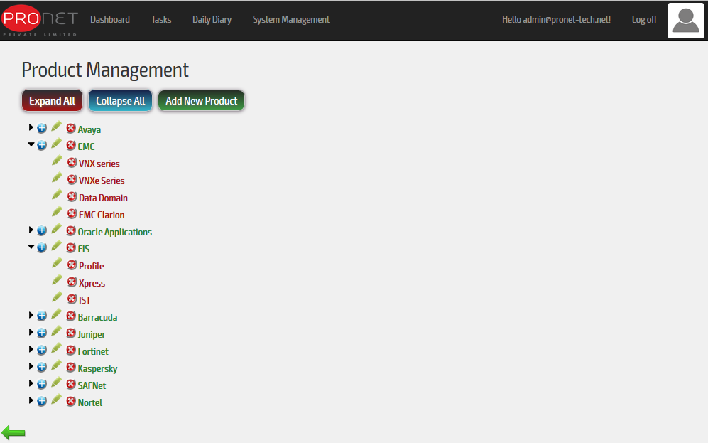
Product, LOB, & Issue Complaint Management:
Product Management: All Products, their relative categorized products and their relative LOB(Line of Business) can be initialized by the user with ‘Admin’ role.

Slide 14
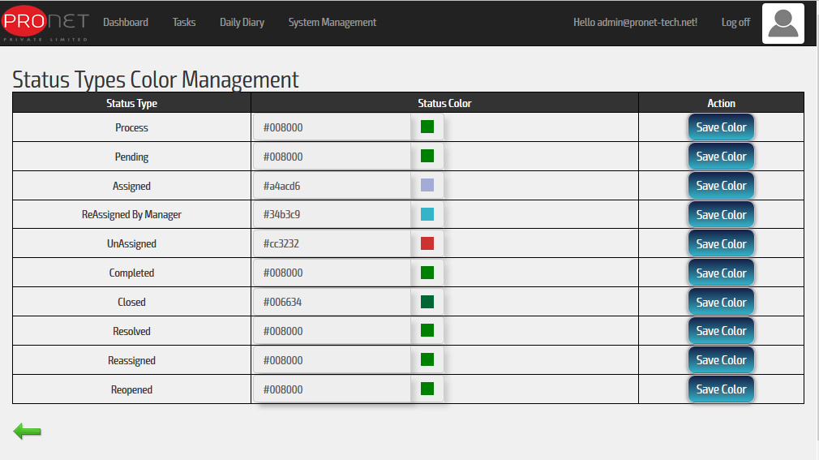
Task Status: User with ‘Admin’ role can only set/edit the color scheme for the task status in the system, to be displayed by user ‘Dashboard’.

Slide 15
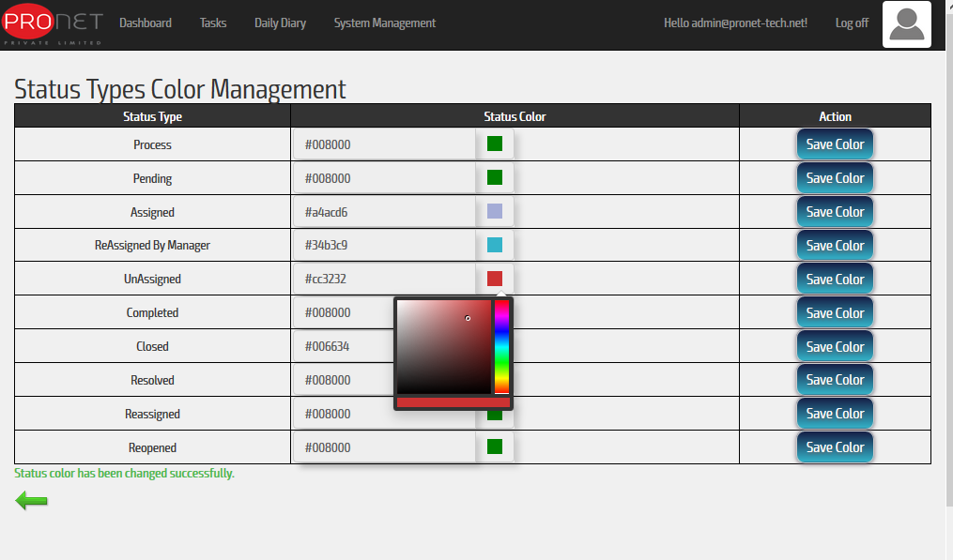

Slide 16
2. Manager: The user with role ‘Manager’ in the software is capable to perform specific task as assigned by role against his assigned products. In this role user can perform majority of ‘Task Management’ like
Task Management
Task Assignment: When a task is assigned, an email is send to mangers, supervisor, and the engineer selected to assign that task.
Task Reassignment: When a task is re-assigned, an email is send to mangers, supervisor, and the engineer selected to re-assign that task.
Closed Task Reassignment: When a task with closed status is re-assigned, an email is send to mangers, supervisor, and the engineer selected to re-assign that task.
View Task Details: Administrator can view all tasks and their details.
Re-open Task: can re-open any closed task.
Daily Diary will also be filled by users with ‘Admin’ role.

Slide 17
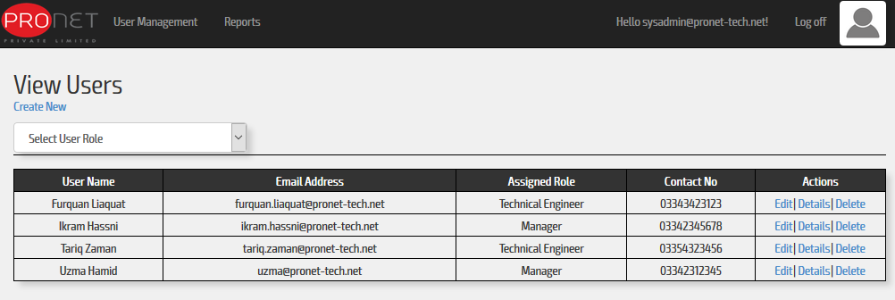
3. System Administrator: User with ‘System Administrator’ can Create, Edit, View Details, or Delete the user accounts.

Slide 18
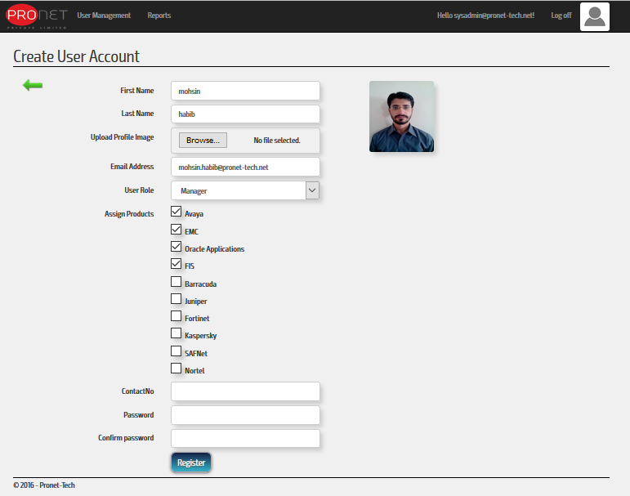
User Creation Wizard: ‘Manager’ role user would be assigned by any of company Products.

Slide 19
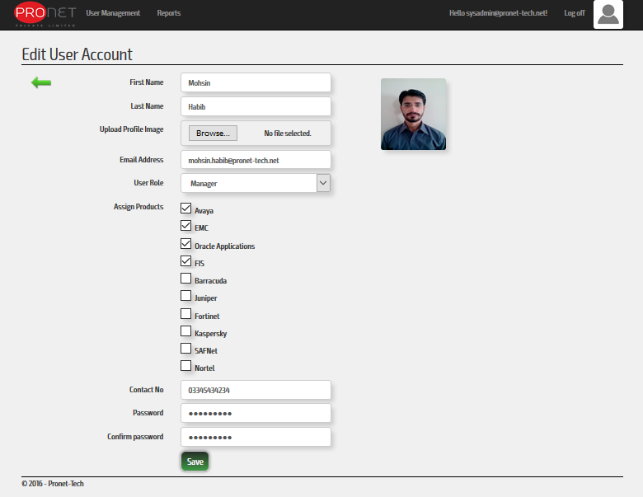
User Update: Any existed/registered user account can be edited by ‘System Administrator’ role user.

Slide 20
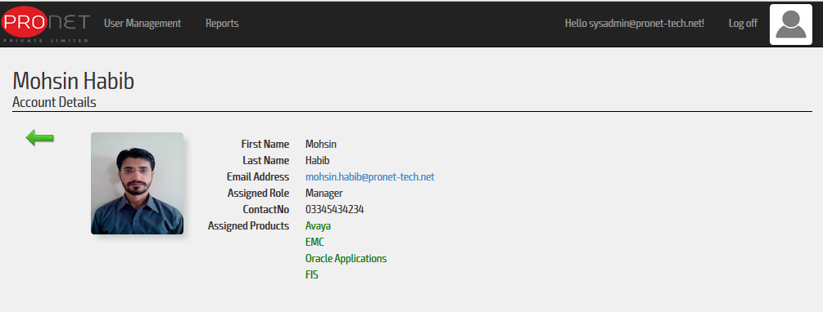
View Individual Details: Any existed/registered user account can be viewed by ‘System Administrator’ role user.

Slide 21
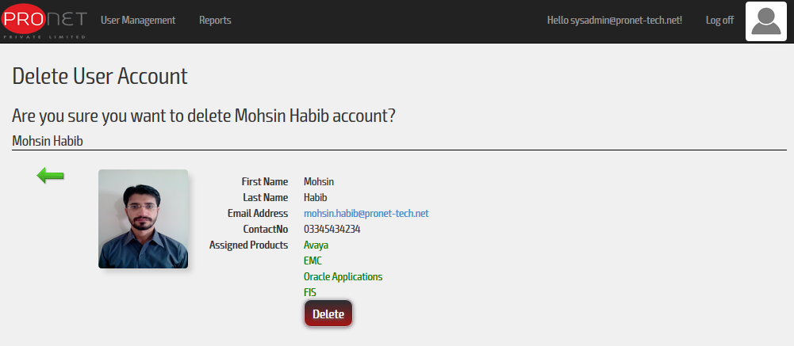
User Deletion: Any existed/registered user account can be deleted by ‘System Administrator’ role user.

Slide 22
Create Reports: ‘System Administrator’ role user can create the following reports.
Issue General Report
Employee Report
Employee Summary Report
Product Report
Product Summary Report
Service Desk System Report
Task Report
Daily Diary Report

Slide 23
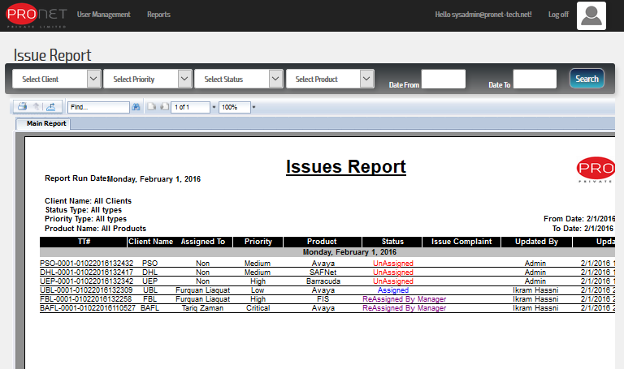
Reports 1.Issue General Report:

Slide 24
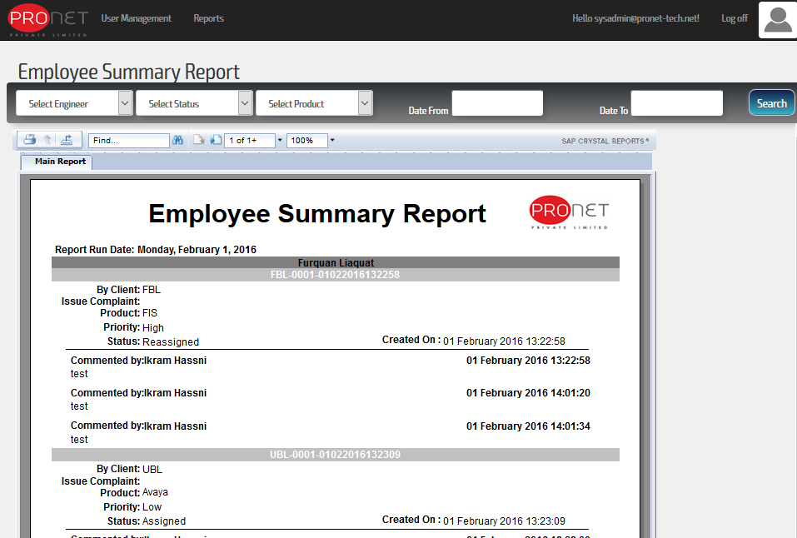
2. Employee Report:

Slide 25
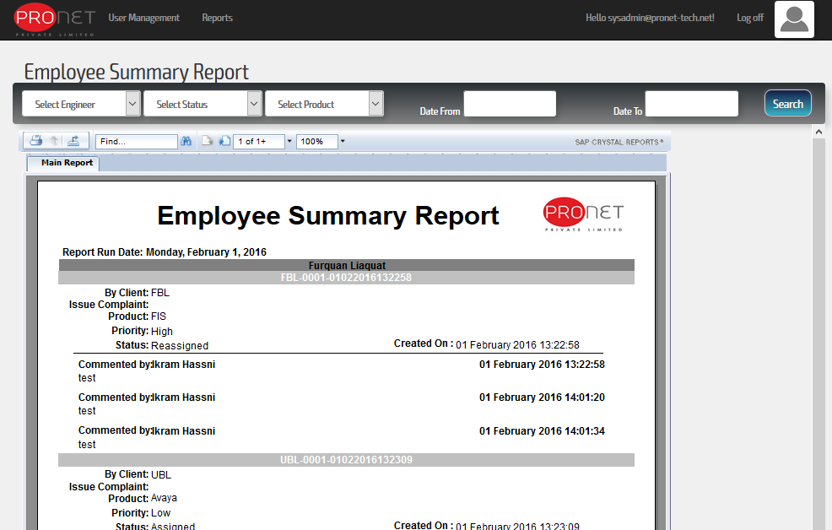
3. Employee Summary Report:

Slide 26
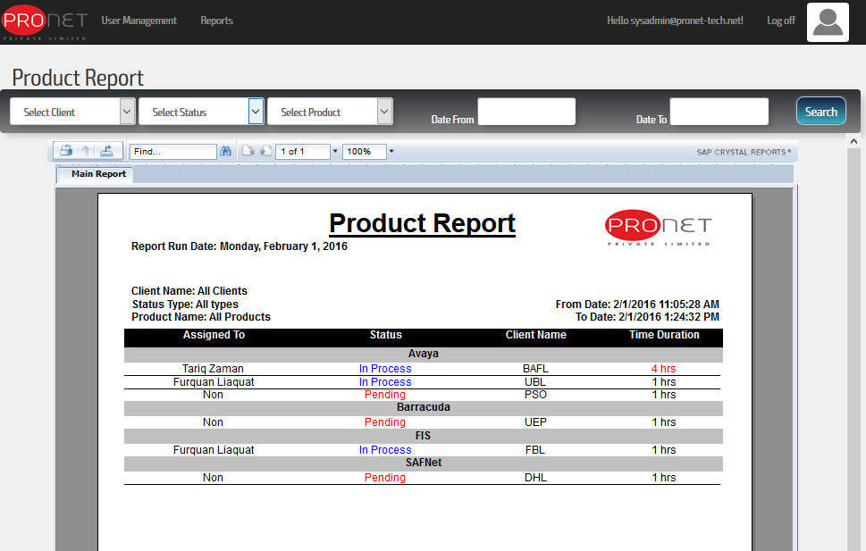
4.Product Report:

Slide 27
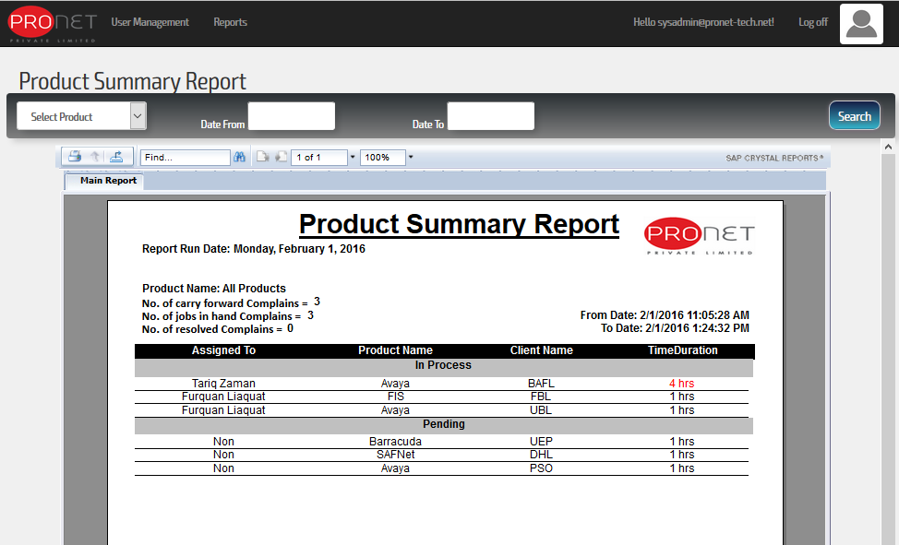
5.Product Summary Report:

Slide 28
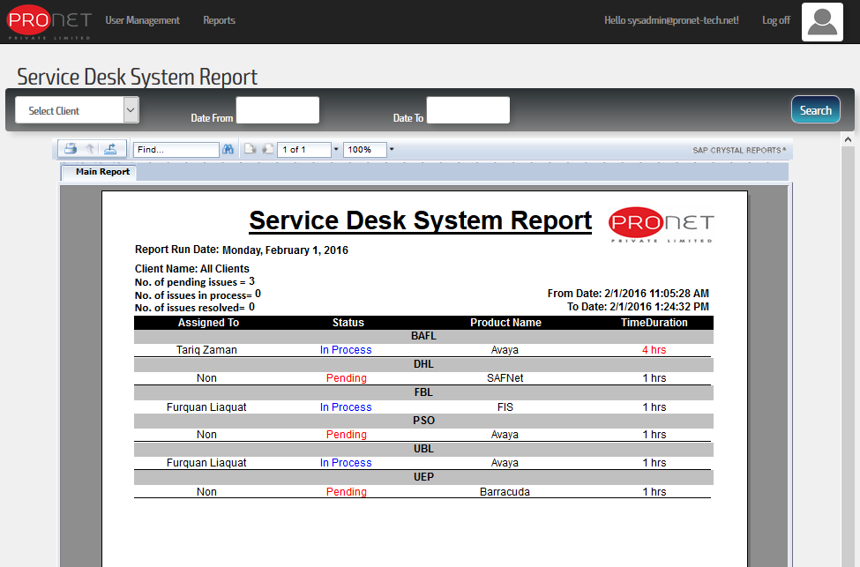
6. Service Desk System Report:

Slide 29
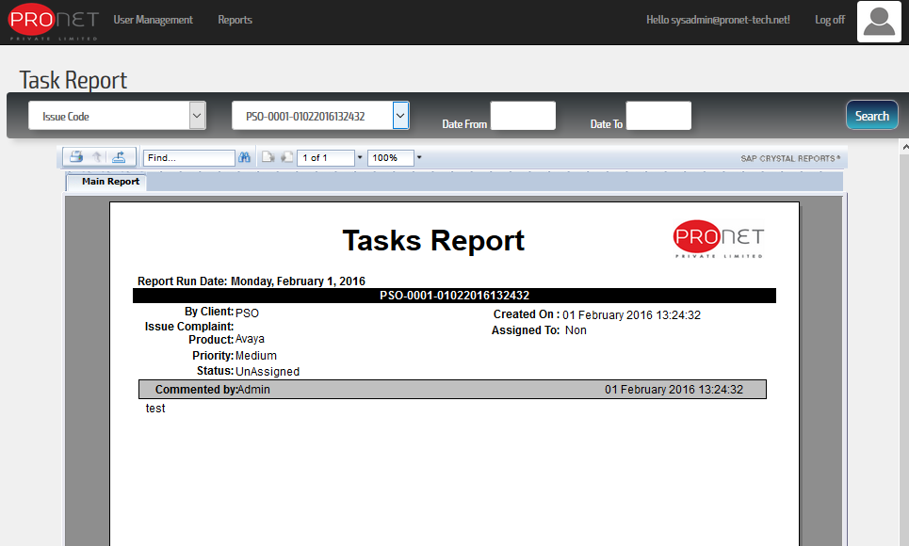
7. Tasks Report:

Slide 30
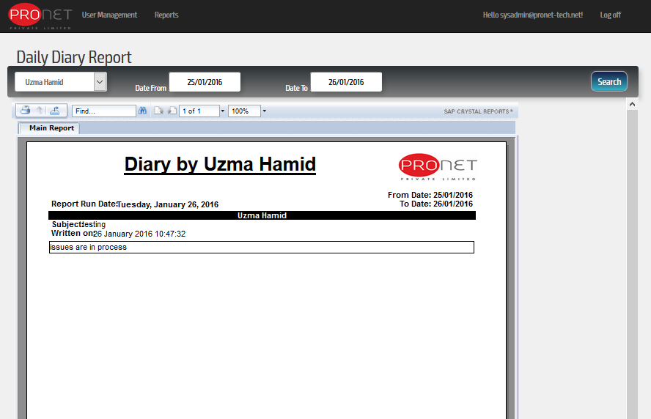
8.Daily Diary Report:

Slide 31
4. Technical Engineer: The user with role ‘Technical Engineer’ is capable to perform his role with the following,
- Task Management
Update Task
Close Task
- Create Reports: System Administrator can create and view any report.
Issue General Report
Employee Report
Employee Summary Report
Product Report
Product Summary Report
Service Desk System Report
Task Report
Daily Diary Report

Slide 32
New CMS Flow

Slide 33
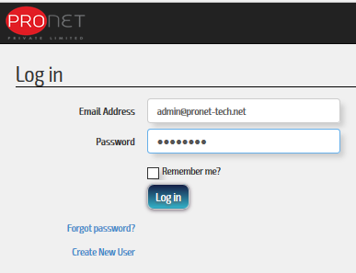
Initially, an end user/default user with ‘Admin’ role is login to the system,

Slide 34
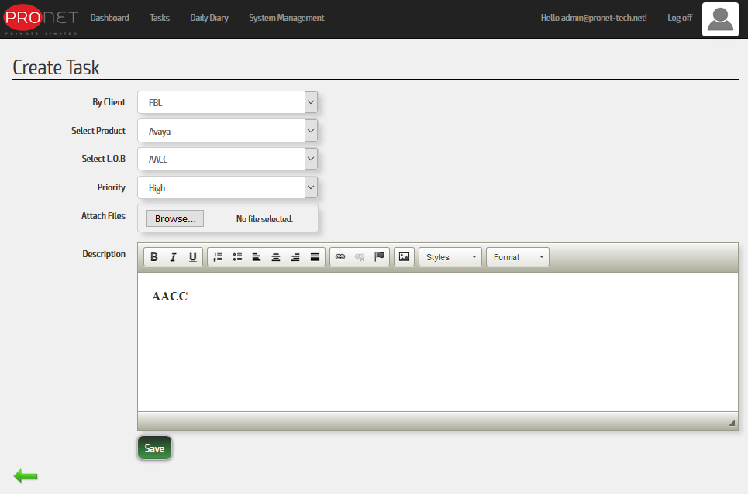
Issue/Task Creation: Task creation is initiated with an email is shoot to their respective ‘Manager’ role users.

Slide 35
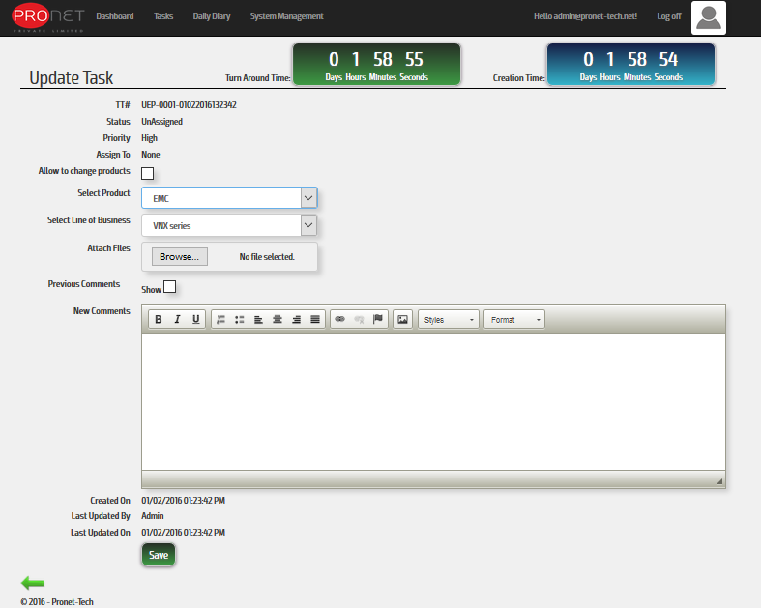
Issue/Task Edition: If required the issue/task can be update, also an email is shoot to its respective ‘Manager’ role users.

Slide 36
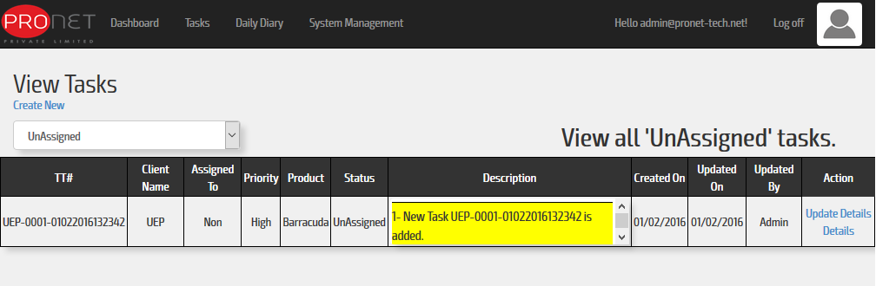
When a issue/task is logged successfully into the system, it can be assigned by its respective ‘Manager’ role user only.

Slide 37
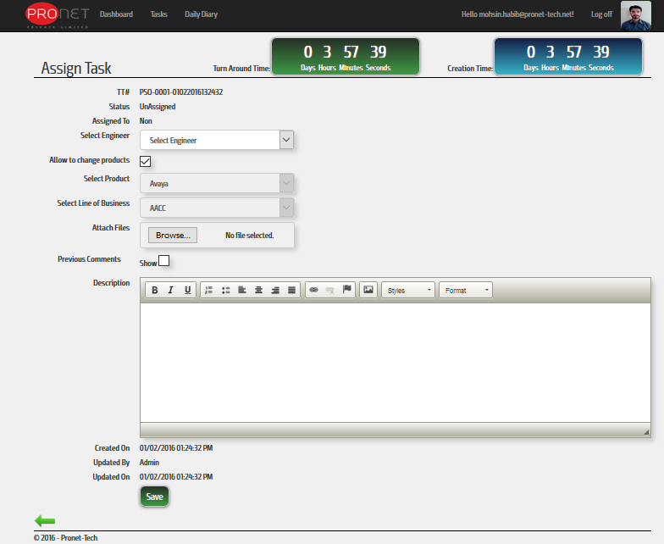
While assigning any issue/task, an email is shoot to the relative assigned ‘Tech-Engineer’ and its Supervisor/Manager.

Slide 38
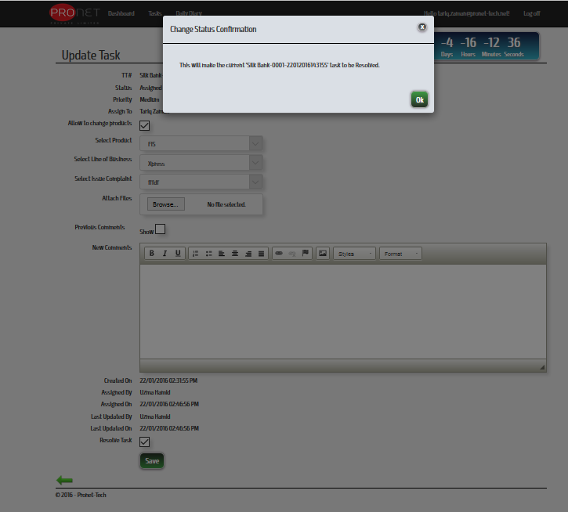
When a issue/task is successfully assigned to a Tech-Engineer then it can be only resolved by that engineer,

Slide 39
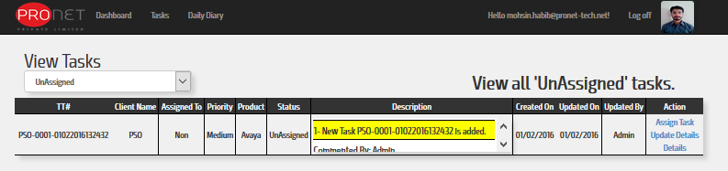
When a issue/task is successfully resolved ,a concurrent email is shoot to his respective Supervisor/Manager, In order to finally ‘Close’ the issue/task by Manager verification.

Slide 40
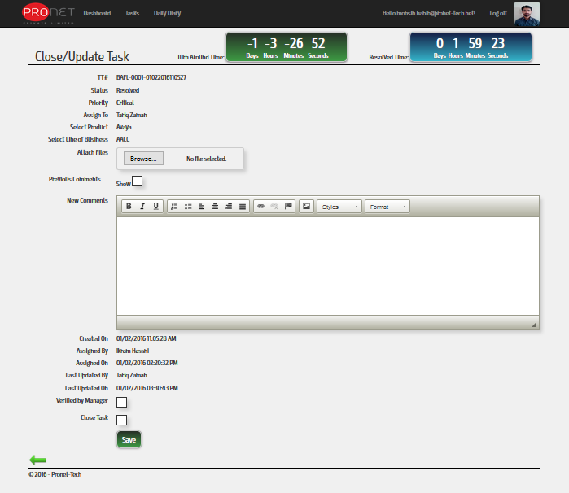

Slide 41
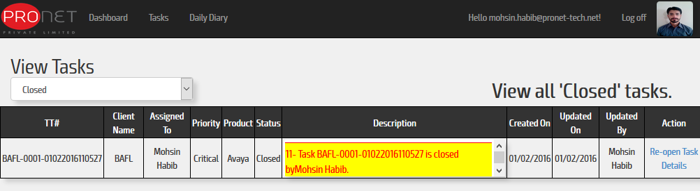
When a issue/task is successfully closed, a concurrent email is shoot to his respective Supervisor/Manager.

Slide 42
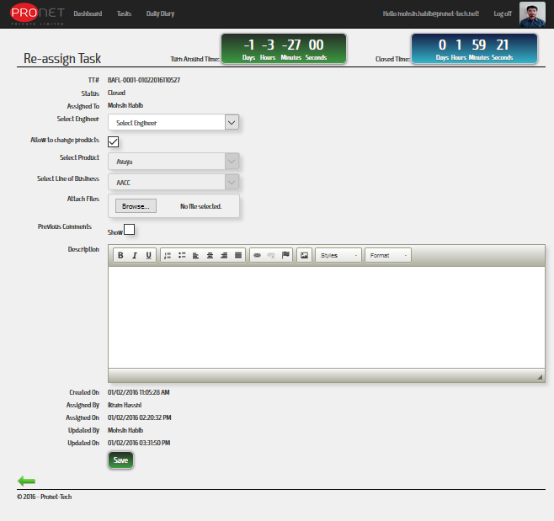
If required, the issue/task can be re-opened by that Manager. With a concurrent email shooting to his respective Supervisor/Manager.

Slide 43
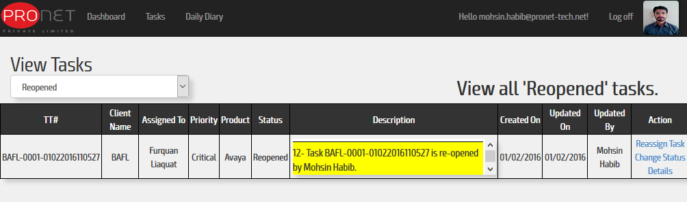
Thus, in this way the task resolution is proceed by the current system.

